Slide 1
Applied Data Science Capstone: A Comparison between Amenities surrounding the Top 5 Most Expensive and Top 5 Least Expensive Areas in Greater Toronto Area
By
Yun En Tan

Slide 2
Introduction
The housing cost in Greater Toronto Area (GTA) has had a significant increase in 2017. Although in the past two years, the federal and provincial government have come up with some policies to prevent further increase in housing cost, the current price of housing in GTA is still significantly higher than pre-2017 era. This has caused young millennials to be priced out of the housing market. In this report, we will be looking into the surrounding areas of GTA's neighbourhood which are among the top 5 most expensive and top 5 least expensive based on Toronto Real Estate Board (TREB)'s Q1 2019 data. With this comparison, we hope that young millennials will be able to find a place in GTA which are relatively affordable but having the same neighbourhood's amenities comparing to the expensive neighbourhood in GTA.

Slide 3
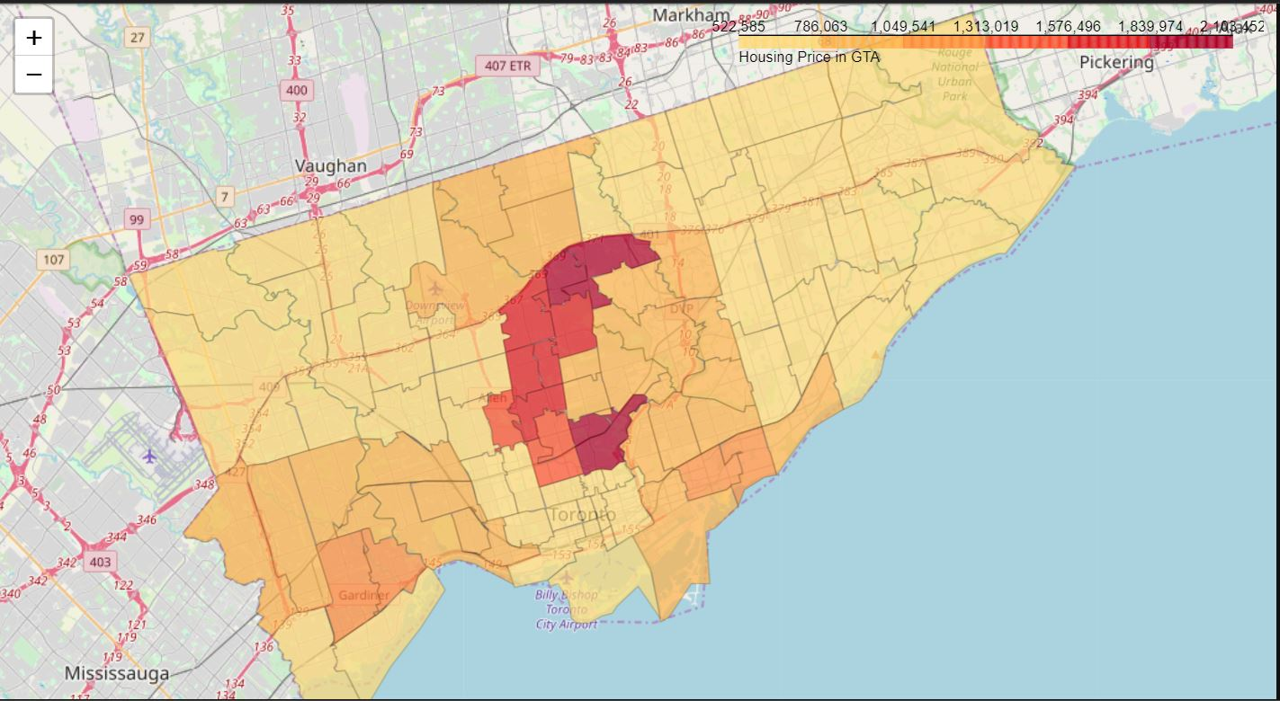
Housing Price in Canada
Figure 1: Heat Map of Housing Price in GTA

Slide 4
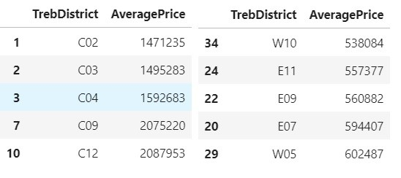
Top 5 Most Expensive and Top 5 Least Expensive TREB Districts
Figure 2: Left diagram is the top 5 most expensive TREB districts, Right is the top 5 least expensive TREB districts

Slide 5
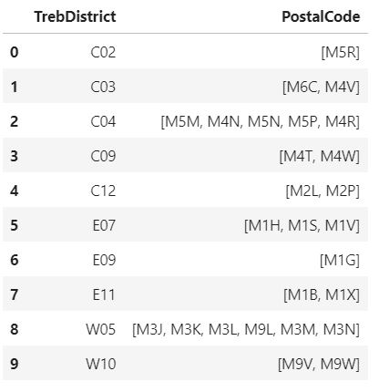
TREB District and Postal Code Maps
Figure 3: Postal Code Mapping of the Top 5 Most Expensive and Top 5 Least Expensive TREB Districts

Slide 6
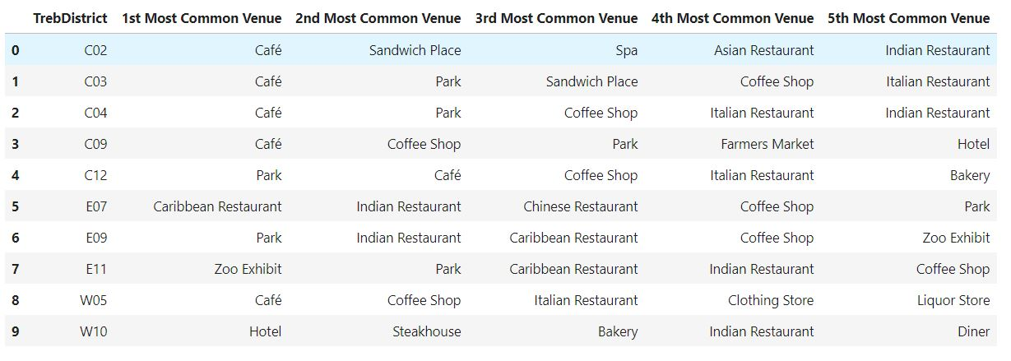
Top 5 Most Common Venues
Figure 4: Top 5 Most Common Venues in the Top 5 Most Expensive and Top 5 Least Expensive TREB districts

Slide 7
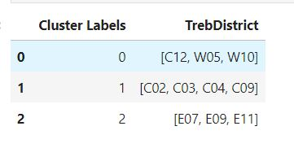
Clustering Results
Figure 5: Clustering Result

Slide 8
Discussion
From Figure 5, we would be prompted to say that W05 and W10 (the relatively cheaper TREB districts) has identical amenities in the surrounding with C12 (one of the most expensive TREB district), however, if we refer to Figure 4, we do see fairly high similarities in venues among W05 and C12, but W10’s surroundings seem completely different than W05 and C12.
Based on the result, among the Top 5 most expensive and Top 5 least expensive TREB districts, only W05 has some similarities in surrounding area with C12.

Slide 9
Conclusion
In conclusion, for young millennials who are looking for surroundings with similar amenities but with a more affordable housing price, we would suggest TREB district W05.

